Slide 1
Date: 11 November 2025

Slide 2




Weekly report: Team Gearbox, Brake, Coupling
Week number : 07
Date: 11/11/2025
Supervisor: Prof. Peter Quell
Group Members :Nehang Jitendra Joshi,Santo Mazumder,Md Razaul Karim Rahat
Presented by -Nehang Jitendra Joshi
11-11-2025
Gearbox, Brake, Coupling

Slide 3
List of Content
1.Torque and rotational speed calculation
2.Dimension overview of the gearbox finalized
3.Calculation of the 1st stage of planetary gear and 2nd stage also Spur gear stage calculation updated
4.Direct Bolted Flange Connection – LSS gearbox and main shaft
11-11-2025
Gearbox, Brake, Coupling

Slide 4
Torque and rotational speed calculation for Rotor and Generator Updated
Rotor side
P rotor | 5.4 MW
nlss | 10.12 rpm
M rotor | 5.095 KN m
Generator side
nhss | 1200 rpm
Ratio i | 1200 /10.12 = 118.57
M generator | 41.9 KNm
11-11-2025
Gearbox, Brake, Coupling

Slide 5
Dimension of the gearbox- Final
Parameter | Dimensions in mm
Total Width of the gearbox | 3200 mm
Gearbox total diameter | 2100 mm
Outer diameter elastomeric bearing | 350 mm
Pin to pin distance from the center | 2600 mm
pin diameter of the lever arm | 275 mm
Bolt length near to elastomeric bearing | 0.540 mm
11-11-2025
Gearbox, Brake, Coupling

Slide 6
Formulas for Planetary gear
z_Ring | z_Sun +( 2 x z_Planet)
z_Planet | z_Sun - z_Ring / 2
No. of Planets | 5 and 4
D_Sun | z_Sun x Module
D_Planets | (D_Ring /2) – (D_Sun/2)
D_Ring | z_Ring x Module
Gap | (D_Sun + D_Planets) * Pi / (No. of Planets) - D_Planets
Face Width | 10 x Module
Tooth Depth | 2.25 x Module
n_Ring | 0
n_Planet Carrier | 10.12 rpm
n_Sun | (1-i_1) x n_Planet Carrier
i_Sun,Planet | z_Planet / z_Sun
n_Planet | n_Sun / i_Sun,Planet
z = No. of Teeth
n = RPM
D = Pitch Circle Diameter
i = Gear Ratio
Reference: Lecture Notes by Prof. Peter Quell
11-11-2025
Gearbox, Brake, Coupling

Slide 7
Updated Calculation for 1st stage of planetary
I-1 ratio | 5.2
D_Planets (mm) | 720
Module mm | 16
z_Sun | 40
z_Ring | 130
z_Planet | 45
No. of Planets | 5
(z_Sun + z_Ring)/No. of Planets | 34
Tooth Depth | 36
D_Sun (mm) | 640
D_Ring (mm) | 2080
Gap (mm) | 694.4
Face Width | 1600
n_Ring (rpm) | 0
n_Planet Carrier (rpm) | 10.12
n_Sun (rpm) | 42.50
i_Sun,Planet | 1.12
n_Planet (rpm) | 40.62
Reference: Lecture Notes by Prof. Peter Quell and PSGdesign book
11-11-2025
Gearbox, Brake, Coupling

Slide 8
Updated Calculation for 2nd stage of planetary
I-2 ratio | 4.7
D_Planets (mm) | 270
Module mm | 9
z_Sun | 40
z_Ring | 100
z_Planet | 30
No. of Planets | 4
(z_Sun + z_Ring)/No. of Planets | 35
Tooth Depth | 20.25
D_Sun (mm) | 360
D_Ring (mm) | 900
Gap (mm) | 137.25
Face Width | 90
n_Ring (rpm) | 0
n_Planet Carrier (rpm) | 78.4
n_Sun (rpm) | 516.56
i_Sun,Planet | 0.75
n_Planet (rpm) | 688.74
Reference: Lecture Notes by Prof. Peter Quell and PSGdesign book
11-11-2025
Gearbox, Brake, Coupling

Slide 9
Spur gear stage calculation
I-3 ratio | 4.8
Module mm | 9
Center distance mm | 585.8
No of teeth on pinion | 108
No.teeth on gear | 22
Width of the gear mm | 90
Hight factor mm | 1
Tooth depth mm | 20.25
Bottom clearance | 2.25
Dia of input shaft mm | 50
Dia of output shaft mm | 85
PCD of pinion | 972
PCD of gear | 198
Face width | 90
Input shaft rpm | 516.56
Output shaft rpm | 1200
Reference: Lecture Notes by Prof. Peter Quell and PSGdesign book
11-11-2025
Gearbox, Brake, Coupling

Slide 10
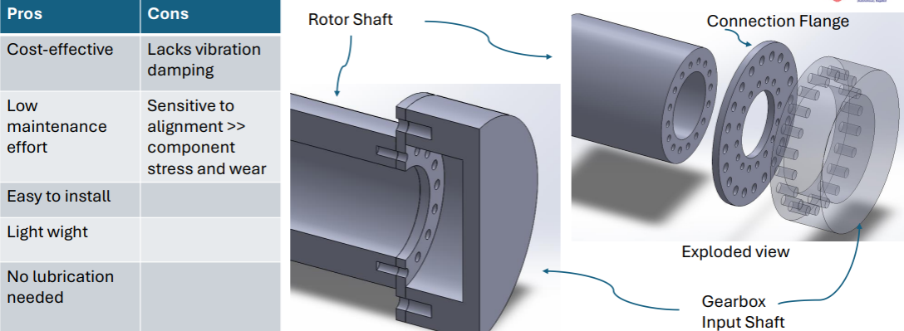
Direct Bolted Flange Connection – LSS gearbox and main shaft
Reference: Optimus Shakti
11-11-2025
Gearbox, Brake, Coupling

Slide 11
Bibliography
Gearbox
(1) Previous year Optimus projects 07-11-2025
(2) Roloff Matek Maschinenelemente 06-11-2025
(3) Lecture notes – Mechanical drive train by Prof.Peter Quell.07-11-2025
(4)Shigley's mechanical engineering design and PSG data book 08-11-2025
(5)thecatalystis.com website 09-11-2025
Coupling
(1)Previous year Optimus project 07-11-2025
11-11-2025
Gearbox, Brake, Coupling

